Slide 1



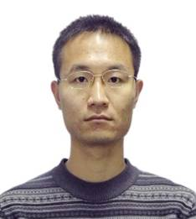
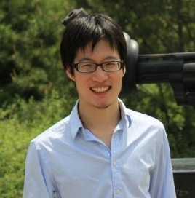
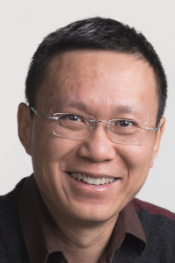
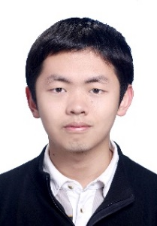
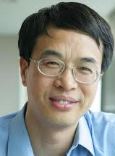
Asymmetric Transitivity Preserving Graph Embedding
Mingdong Ou Peng Cui Jian Pei Ziwei Zhang Wenwu Zhu
Tsinghua U Tsinghua U Simon Fraser U Tsinghua U Tsinghua U

Slide 2
Graph Embedding
Graph Data
Application
Graph Data Representation
Social Network
Similarity Measure
Citation/
Collaboration
Link Prediction
Image/Video Tag/Caption
Clustering/
Classification
Web Hyperlink
Graph Embedding
Visualization
Etc.
Etc.

Slide 3
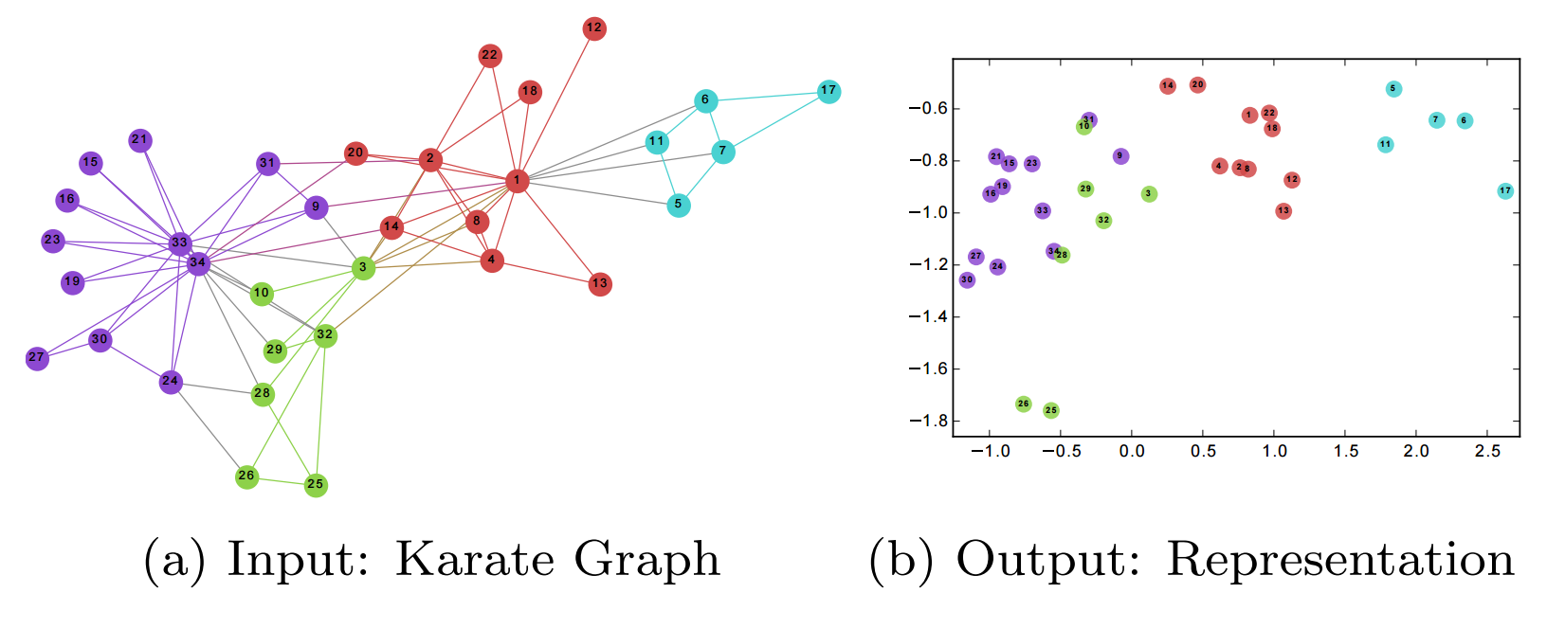
Graph Embedding
Graph Embedding:
Input graph/network → Low dimensional space
Advantages:
Fast computation of nodes similarity
Utilization of vector-based machine learning techniques
Facilitating parallel computing

Slide 4
Existing graph embedding methods
Existing work:
LINE(Tang J, et al. WWW 2015): explicitly preserves first-order and second-order proximity
DeepWalk(Perozzi B, et al. KDD 2014): random walk on graphs + SkipGram Model from NLP
GraRep(Cao S, et al. CIKM 2015)
SDNE(Daixin W, et al. KDD 2016)
Most methods focus on undirected graph

Slide 5
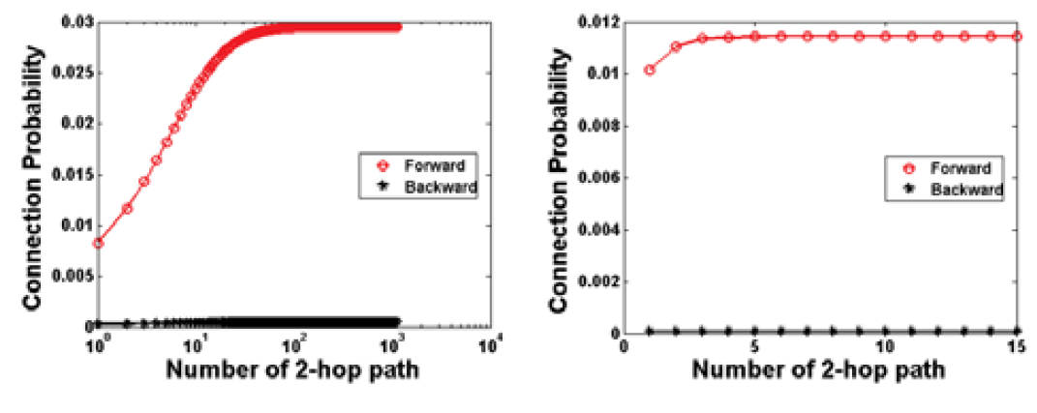
Directed Graph
Critical property in directed graph: Asymmetric Transitivity
Transitivity is Asymmetric in directed graph:
Key in graph inference.
Data Validation: Tencent Weibo and Twitter
Asymmetric transitivity is important!
B
A
C

Slide 6
Asymmetric Transitivity → Graph Embedding
Challenge: incorporate asymmetric transitivity in graph embedding
Problem: metric space is symmetric
asymmetric transitivity metric space
B
Conflict !
A
C
A
C

Slide 7
Asymmetric Transitivity → Graph Embedding
Directed graph embedding: use two vectors to represent each node
LINE(Tang J, et al. WWW 2015): second-order proximity is directed
PPE(Song H H, et al. SIGCOMM 2009): using sub-block of the proximity matrix
Asymmetric: YES; Transitive: NO!
Source(U)
Target(V)
A
A
B
Solved?
B
?
B
A
C
C
C

Slide 8
Similarity metric with asymmetric transitivity
Asymmetric transitivity:
Asymmetry: not symmetric in directed graph
Transitivity:
More directed paths, larger similarity
Shorter paths, larger similarity
Compare A -> C similarity:
> >
High-order Proximity!
(E.g. Katz, Rooted PageRank)
B₁
A
B₁
A
B₂
C
A
B
C
C
B₂
B₃

Slide 9
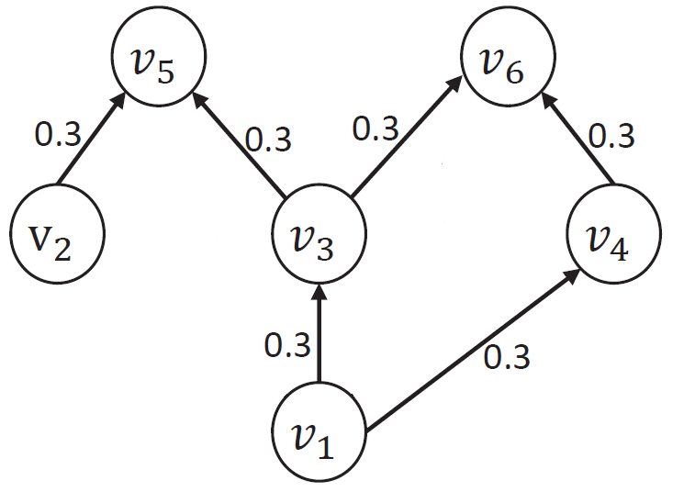

High-Order Proximity
Solution: directly model transitivity using high-order proximity
Example: Katz Index
$A$: adjacency matrix, $β$: decaying constant
$$S^{Katz}=\sum_{l=1}^{+∞}{{\left(β⋅A\right)}^{l}}$$
Example: when $β=1$
0.18
0.09

Slide 10
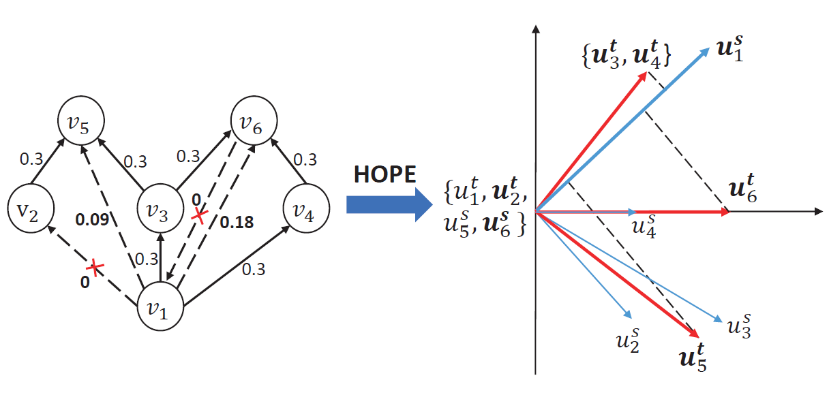
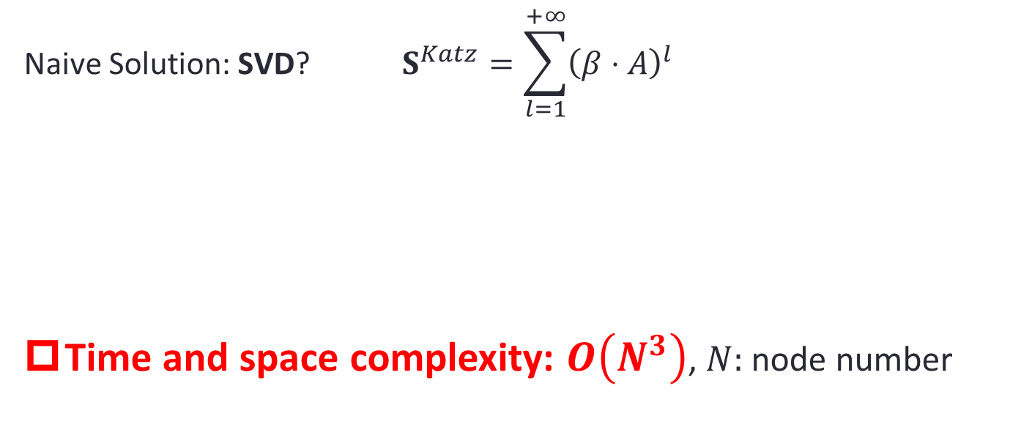
Preserve high-order proximity embedding
$$\text{Naive} \text{Solution}\text{: }\text{SVD}\text{?} S^{Katz}=\sum_{l=1}^{+∞}{{\left(β⋅A\right)}^{l}}$$
Time and space complexity: $O\left(N^{3}\right)$, $N:$ node number
S^{Katz}
U^{s}
U^{t}

Slide 11
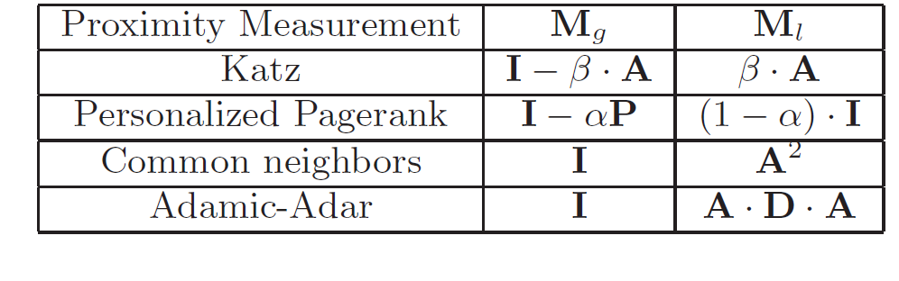

High-Order Proximity: a general form
Katz Index:
$S^{Katz}=\sum_{l=1}^{+∞}{{\left(β⋅A\right)}^{l}}={\left(I−β⋅A\right)}^{−1}⋅\left(β⋅A\right)$
General Form
$$M_{g}^{−1}⋅M_{l}$$
where $M_{g},M_{l}$ are polynomial of adjacency matrix or its variants
General Formulation for High-Order Proximity measurements

Slide 12
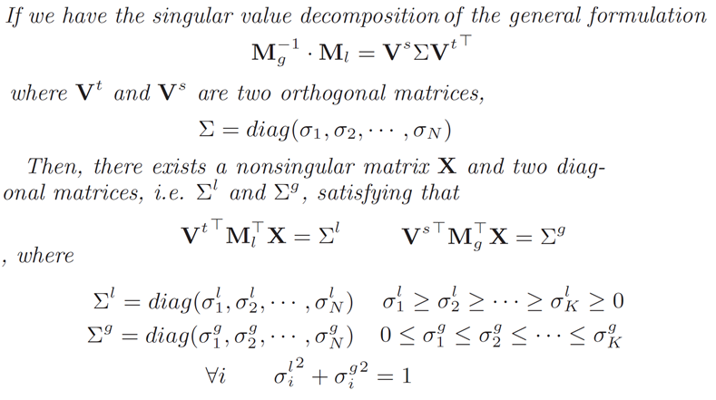

The Power of General Form
$${\min_{U_{s},U_{t}}\left\|S−U_{s}⋅U_{t}^{T}\right\|}_{F}^{2}$$
$$S=M_{g}^{−1}⋅M_{l}$$
Generalized SVD (Singular Value Decomposition) theorem

Slide 13


The Power of General Form
$${\min_{U_{s},U_{t}}\left\|S−U_{s}⋅U_{t}^{T}\right\|}_{F}^{2}$$
$$S=M_{g}^{−1}⋅M_{l}$$
Generalized SVD: decompose $S$ without actually calculating it
JDGSVD: Time Complexity
$$O\left(K^{2}L⋅m\right)$$
Embedding Dimension Iteration Edge number
(constant) (constant)
Linear complexity w.r.t. the volume of data (i.e. edge number)
--> Scalable algorithm, suitable for large-scale data

Slide 14
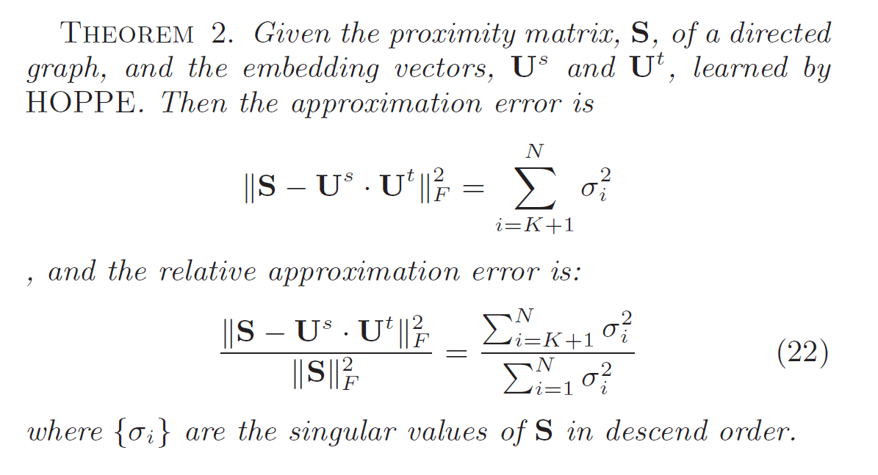
Theoretical Guarantee
Approximation Error Upper Bound:

Slide 15
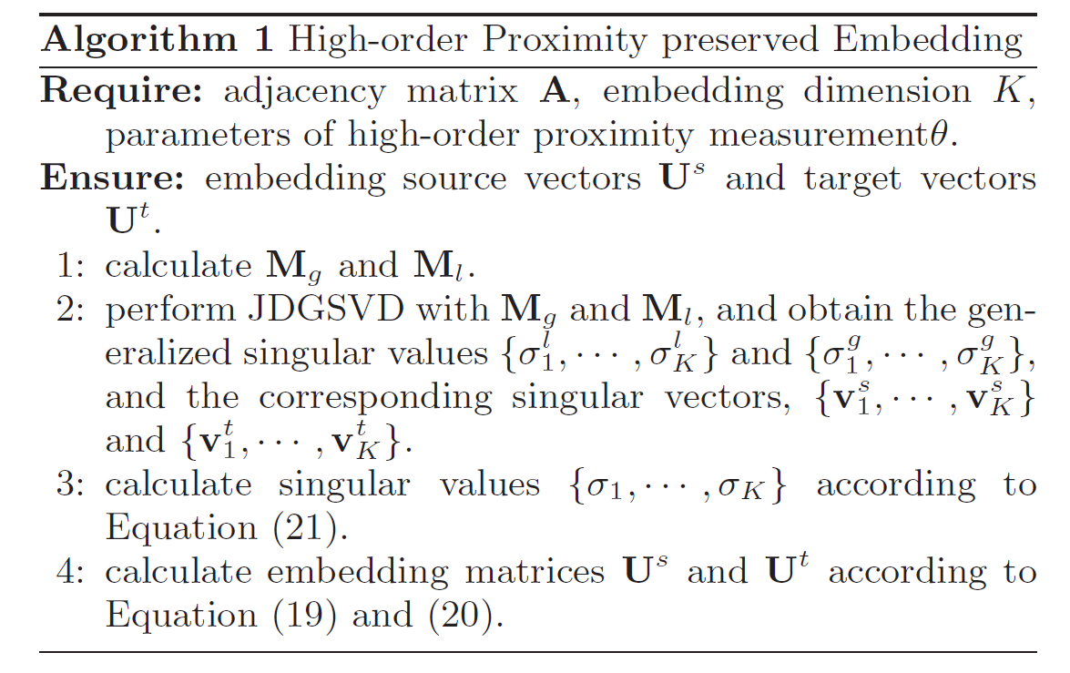
HOPE: HIGH-ORDER PROXIMITY
PRESERVED EMBEDDING
HOPE: High-Order Proximity preserved Embedding
Algorithm framework:

Slide 16
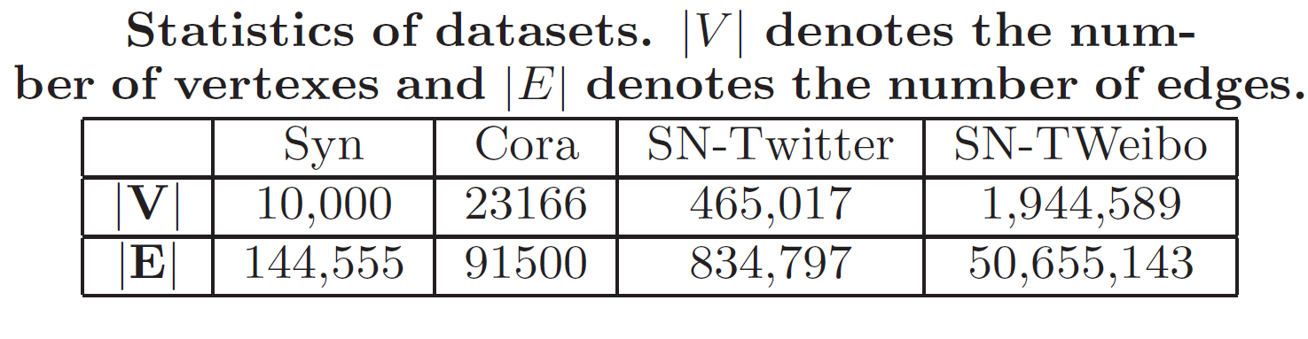
Experiment Setting: Datasets
Datasets:
Synthetic (Syn): generate using Forest Fire Model
Cora¹: citation network of academic papers
SN-Twitter²: Twitter Social Network
SN-TWeibo³: Tencent Weibo Social Network
¹http://konect.uni-koblenz.de/networks/subelj_cora
²http://konect.uni-koblenz.de/networks/munmun_twitter_social
³http://www.kddcup2012.org/c/kddcup2012-track1/data

Slide 17
Experiment Setting: Task
Approximation accuracy
High-order proximity approximation: how well can embedded vectors approximate high-order proximity
Reconstruction
Graph Reconstruction: how well can embedded vectors reconstruct training sets
Inference:
Link Prediction: how well can embedded vectors predict missing edges
Vertex Recommendation: how well can embedded vectors recommend vertices for each node

Slide 18
Experiment Setting: Baseline
Graph embedding
PPE: approximate high-order proximity by selecting landmarks and using sub-block of the proximity matrix
LINE: preserves first-order and second-order proximity, called LINE1 and LINE2 respectively
DeepWalk: random walk on graphs + SkipGram Model
Task Specific:
Common Neighbors: used for link prediction and vertex recommendation task
Adamic-Adar: used for link prediction and vertex recommendation task

Slide 19
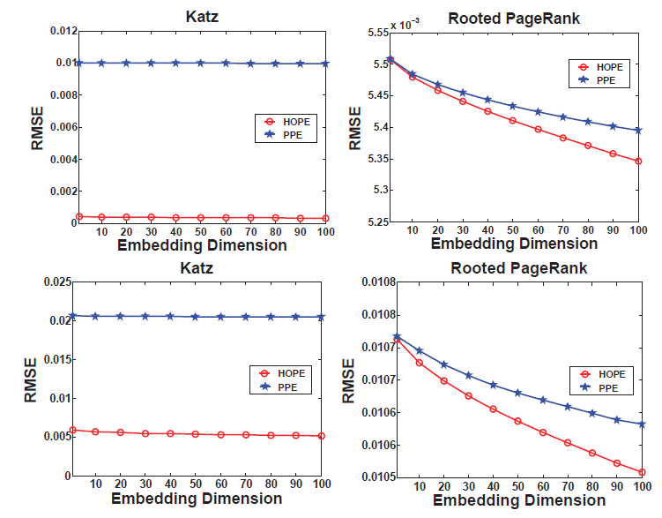
Experiment result:
high-order Proximity Approximation
Conclusion: HOPE achieves much smaller RMSE error
-> generalized SVD achieves a good approximation
x10
x4

Slide 20
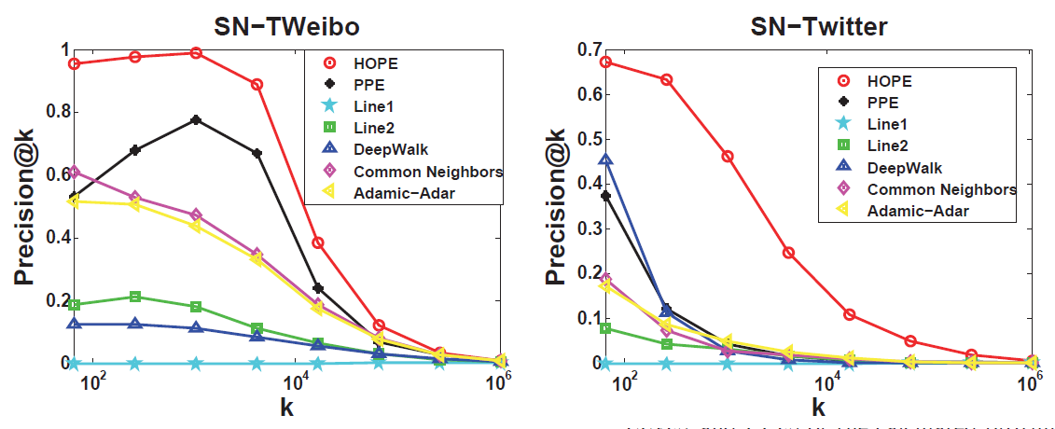
Experiment result: Graph Reconstruction
Conclusion: HOPE successfully capture the information of training sets
+50%
+100%

Slide 21
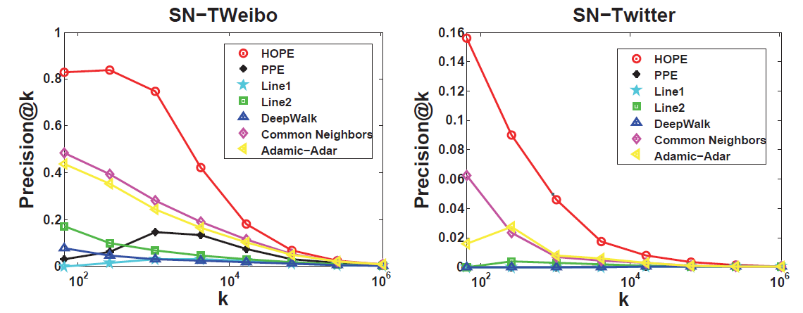
Experiment result: Link Prediction
Conclusion: HOPE has good inference ability
-> based on asymmetric transitivity
+100%
+100%

Slide 22
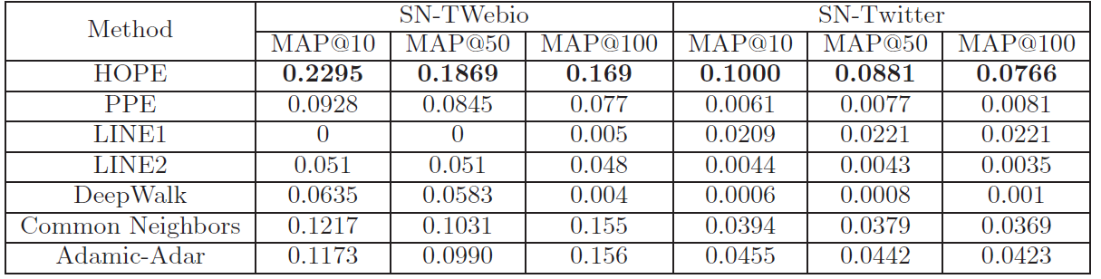
Experiment result: Vertex Recommendation
Conclusion: HOPE significantly outperforms all state-of-the-art baselines on all these experiments
+88% improvement
+81% improvement

Slide 23
Conclusion
Directed graph embedding:
High-order Proximity → Asymmetric Transitivity
Derivation of a general form for high-order proximities, and solution with generalized SVD
Covering multiple commonly used high order proximity
Time complexity linear w.r.t. graph size
Theoretically guaranteed accuracy.
Extensive experiments on several datasets
Outperforming all baselines in various applications.
x4/x10 smaller approximation error for Katz
+50% improvement in reconstruction and inference

Slide 24
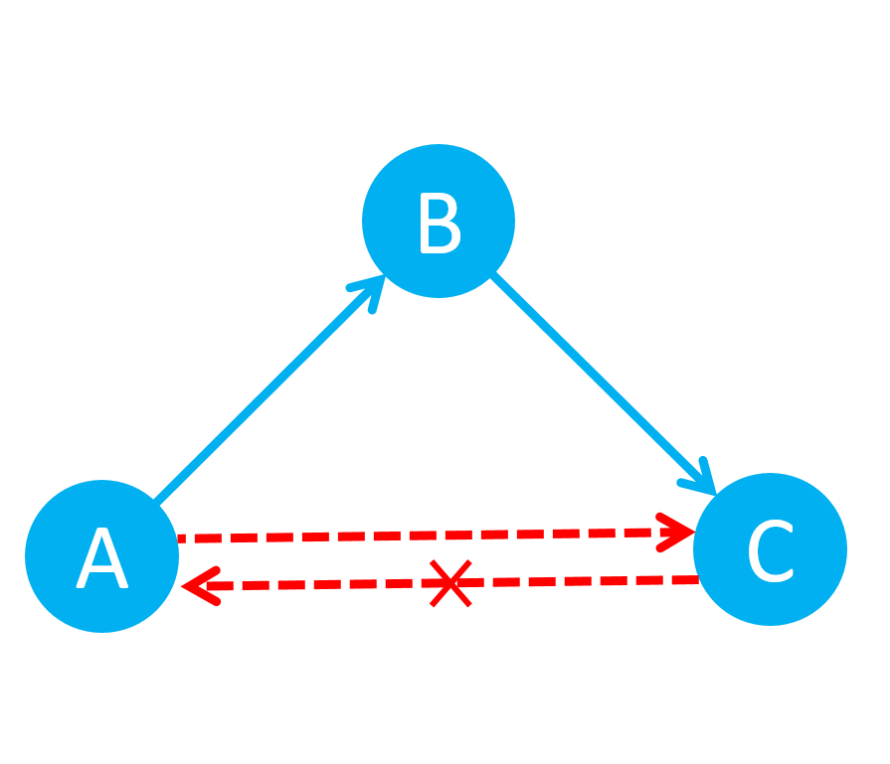
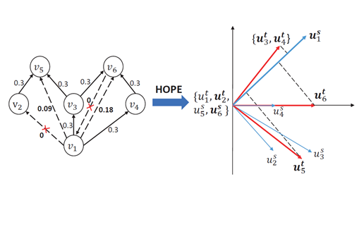
Thanks!
Ziwei Zhang, Tsinghua University
zw-zhang16@mails.tsinghua.edu.com
https://cn.linkedin.com/in/zhangziwei

